Slide 1
Memory Management
Chapter 4
4.1 Basic memory management
4.2 Swapping
4.3 Virtual memory
4.4 Page replacement algorithms
4.5 Modeling page replacement algorithms
4.6 Design issues for paging systems
4.7 Implementation issues
4.8 Segmentation

Slide 2
Memory Management
Ideally programmers want memory that is
  large
  fast
  non volatile
Memory hierarchy
  small amount of fast, expensive memory – cache
  some medium-speed, medium price main memory
  gigabytes of slow, cheap disk storage
Memory manager handles the memory hierarchy

Slide 3

Basic Memory Management
Monoprogramming without Swapping or Paging
Three simple ways of organizing memory
- an operating system with one user process

Slide 4
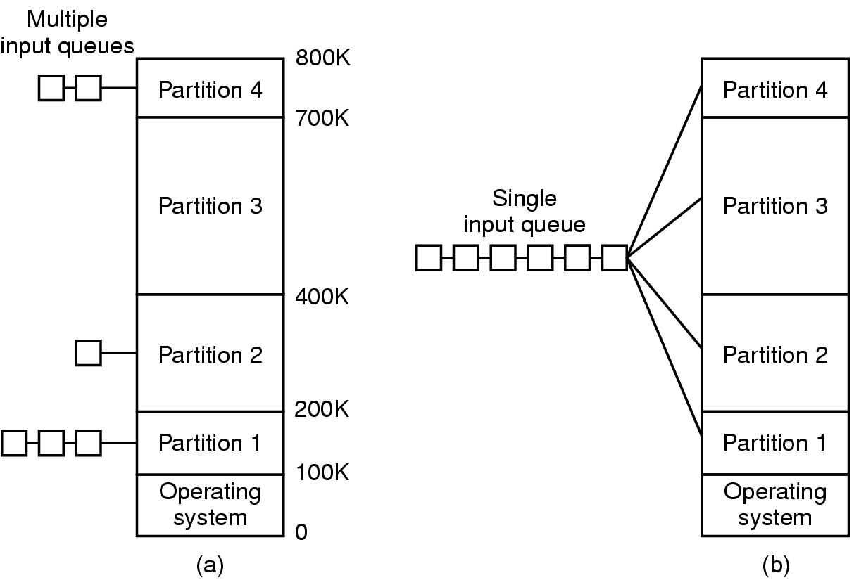
Multiprogramming with Fixed Partitions
Fixed memory partitions
  separate input queues for each partition
  single input queue

Slide 5
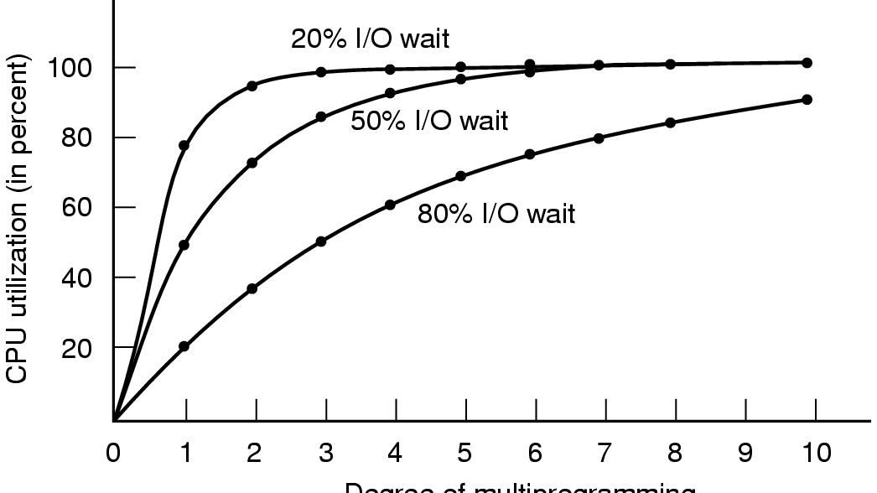
Modeling Multiprogramming
Degree of multiprogramming
CPU utilization as a function of number of processes in memory

Slide 6
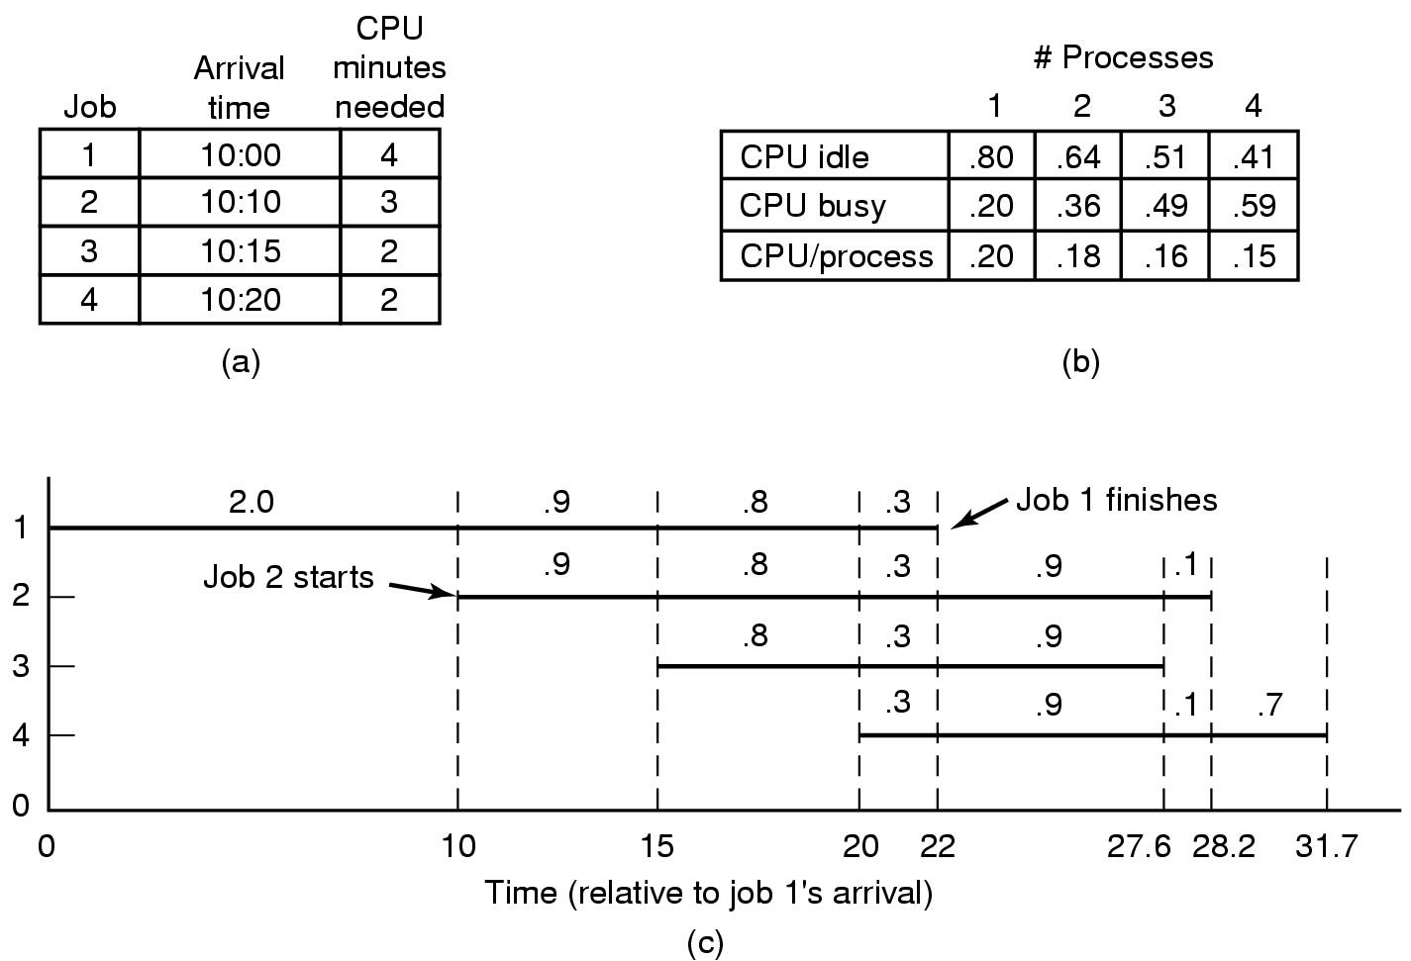
Analysis of Multiprogramming System Performance
Arrival and work requirements of 4 jobs
CPU utilization for 1 – 4 jobs with 80% I/O wait
Sequence of events as jobs arrive and finish
  note numbers show amout of CPU time jobs get in each interval

Slide 7
Relocation and Protection
Cannot be sure where program will be loaded in memory
  address locations of variables, code routines cannot be absolute
  must keep a program out of other processes’ partitions
Use base and limit values
  address locations added to base value to map to physical addr
  address locations larger than limit value is an error

Slide 8

Swapping (1)
Memory allocation changes as
  processes come into memory
  leave memory
Shaded regions are unused memory

Slide 9

Swapping (2)
Allocating space for growing data segment
Allocating space for growing stack & data segment

Slide 10

Memory Management with Bit Maps
Part of memory with 5 processes, 3 holes
  tick marks show allocation units
  shaded regions are free
Corresponding bit map
Same information as a list

Slide 11
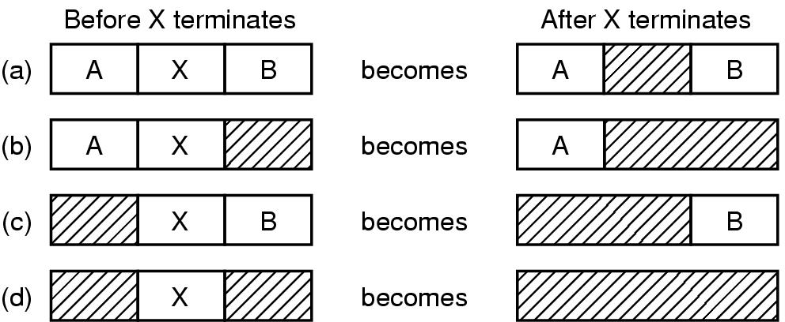
Memory Management with Linked Lists
Four neighbor combinations for the terminating process X

Slide 12

Virtual Memory
Paging (1)
The position and function of the MMU

Slide 13
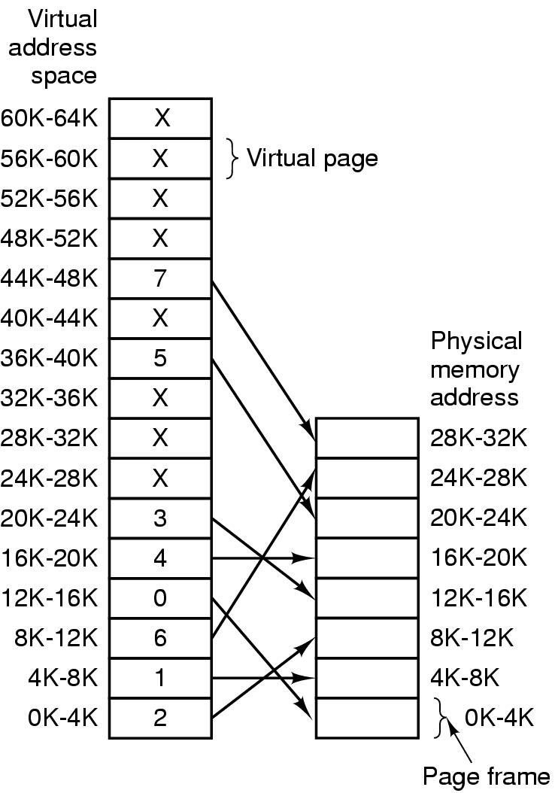
Paging (2)
The relation between
virtual addresses
and physical
memory addres-
ses given by
page table

Slide 14

Page Tables (1)
Internal operation of MMU with 16 4 KB pages

Slide 15

Page Tables (2)
Second-level page tables
Top-level
page table
32 bit address with 2 page table fields
Two-level page tables

Slide 16

Page Tables (3)
Typical page table entry

Slide 17
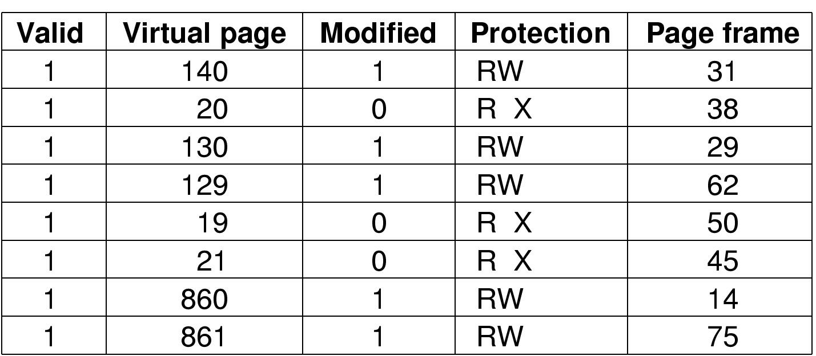
TLBs – Translation Lookaside Buffers
A TLB to speed up paging

Slide 18
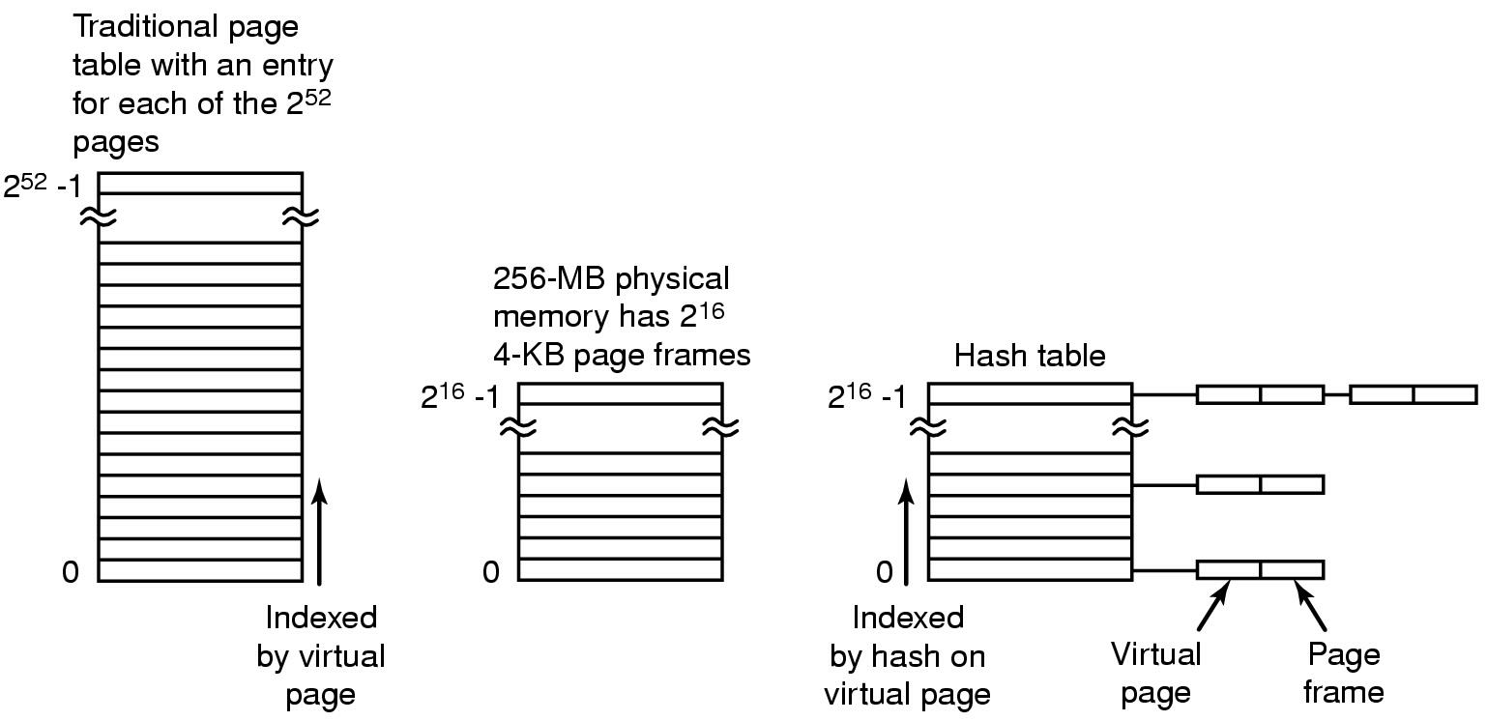
Inverted Page Tables
Comparison of a traditional page table with an inverted page table

Slide 19
Page Replacement Algorithms
Page fault forces choice
  which page must be removed
  make room for incoming page
Modified page must first be saved
  unmodified just overwritten
Better not to choose an often used page
  will probably need to be brought back in soon

Slide 20
Optimal Page Replacement Algorithm
Replace page needed at the farthest point in future
  Optimal but unrealizable
Estimate by …
  logging page use on previous runs of process
  although this is impractical

Slide 21
Not Recently Used Page Replacement Algorithm
Each page has Reference bit, Modified bit
  bits are set when page is referenced, modified
Pages are classified
  not referenced, not modified
  not referenced, modified
  referenced, not modified
  referenced, modified
NRU removes page at random
  from lowest numbered non empty class

Slide 22
FIFO Page Replacement Algorithm
Maintain a linked list of all pages
  in order they came into memory
Page at beginning of list replaced
Disadvantage
  page in memory the longest may be often used

Slide 23
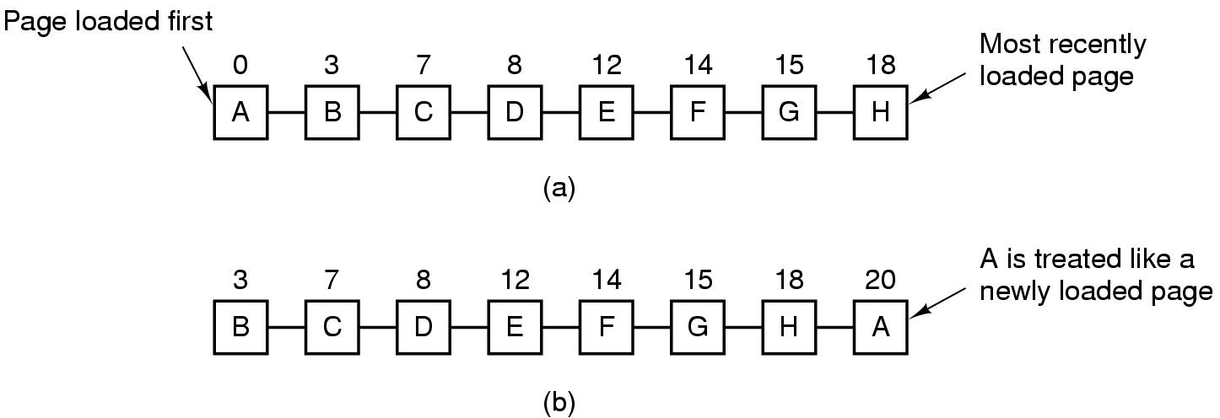
Second Chance Page Replacement Algorithm
Operation of a second chance
  pages sorted in FIFO order
  Page list if fault occurs at time 20, A has R bit set
  (numbers above pages are loading times)

Slide 24
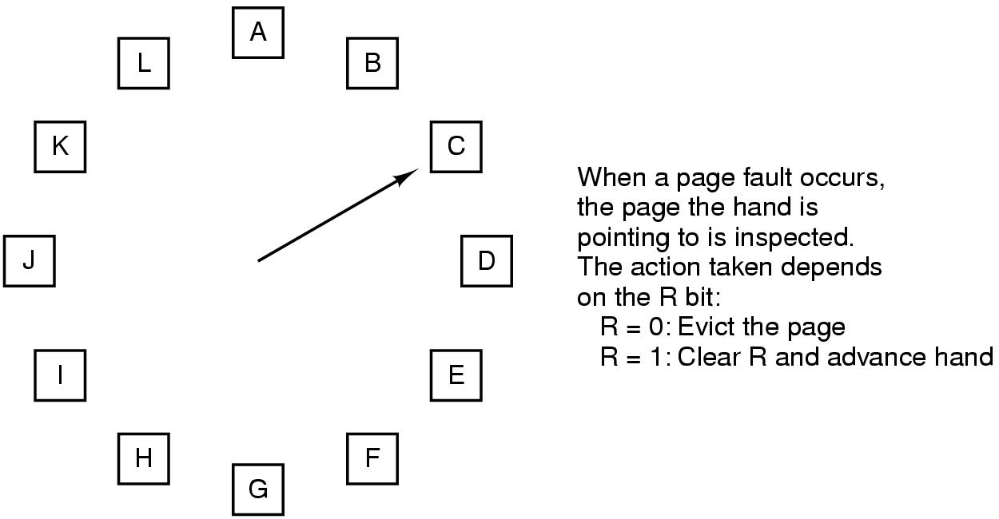
The Clock Page Replacement Algorithm

Slide 25
Least Recently Used (LRU)
Assume pages used recently will used again soon
  throw out page that has been unused for longest time
Must keep a linked list of pages
  most recently used at front, least at rear
  update this list every memory reference !!
Alternatively keep counter in each page table entry
  choose page with lowest value counter
  periodically zero the counter

Slide 26
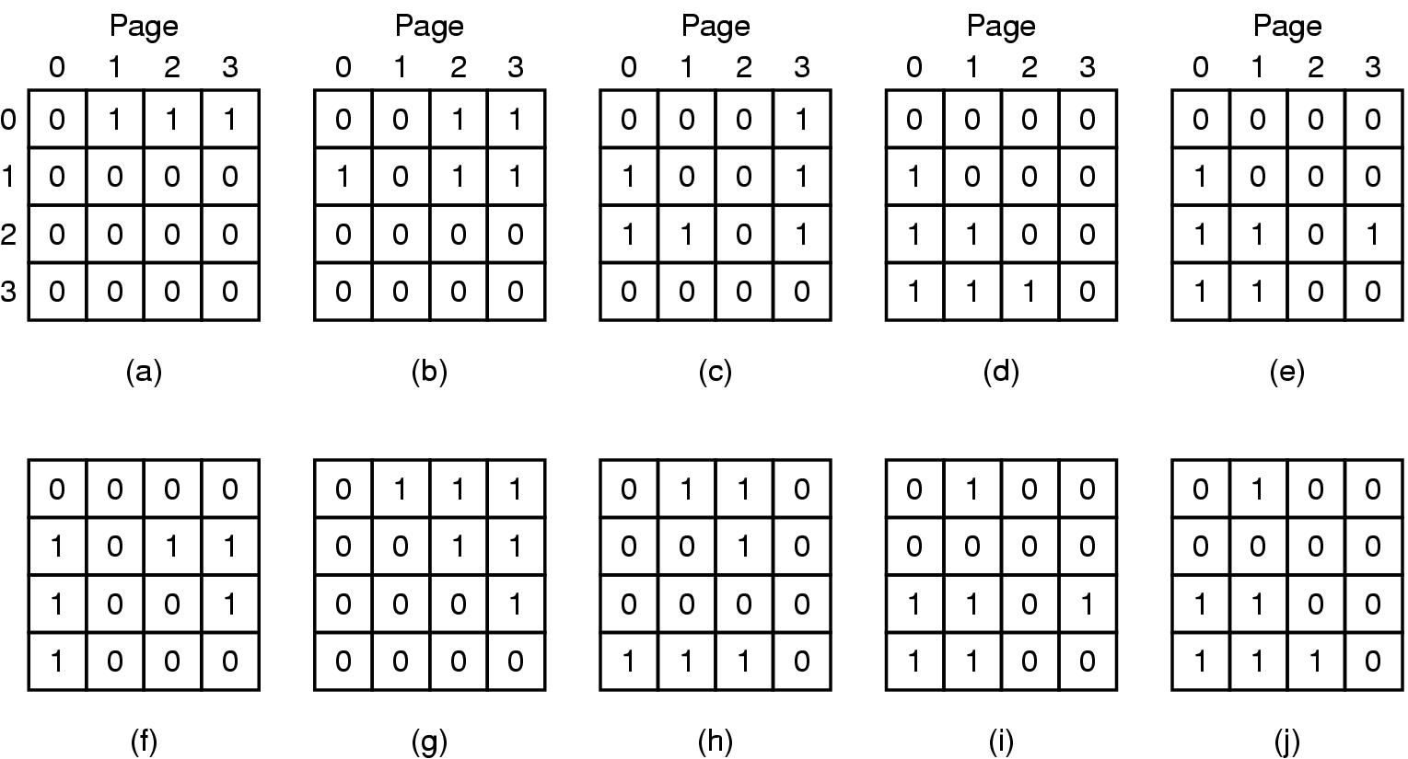
Simulating LRU in Software (1)
LRU using a matrix – pages referenced in order 0,1,2,3,2,1,0,3,2,3

Slide 27
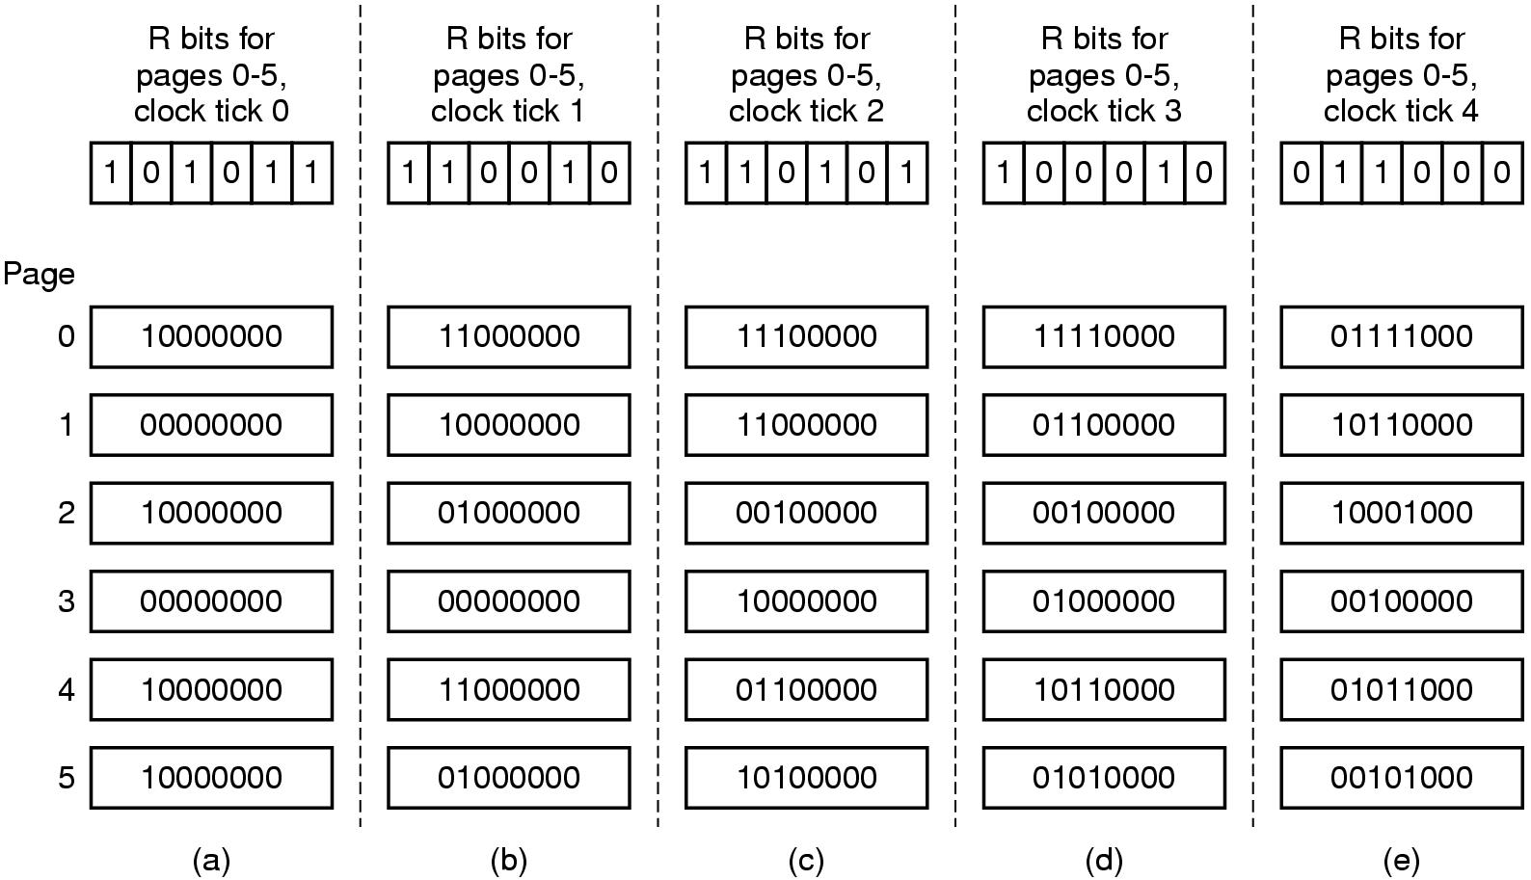
Simulating LRU in Software (2)
The aging algorithm simulates LRU in software
Note 6 pages for 5 clock ticks, (a) – (e)

Slide 28
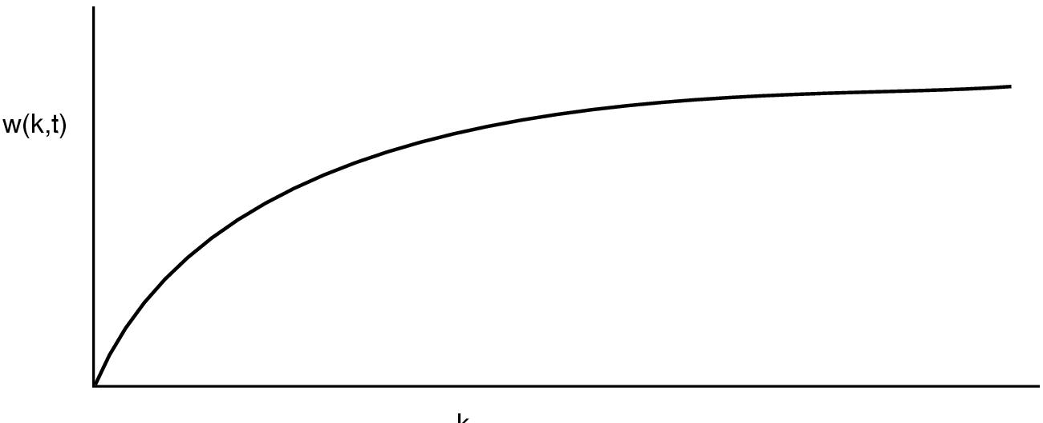
The Working Set Page Replacement Algorithm (1)
The working set is the set of pages used by the k most recent memory references
w(k,t) is the size of the working set at time, t

Slide 29
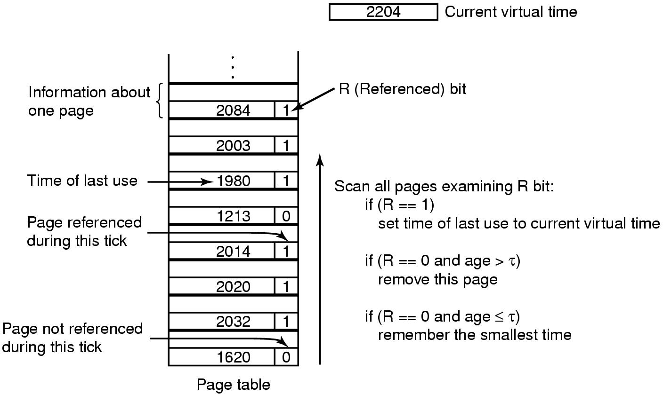
The Working Set Page Replacement Algorithm (2)
The working set algorithm

Slide 30
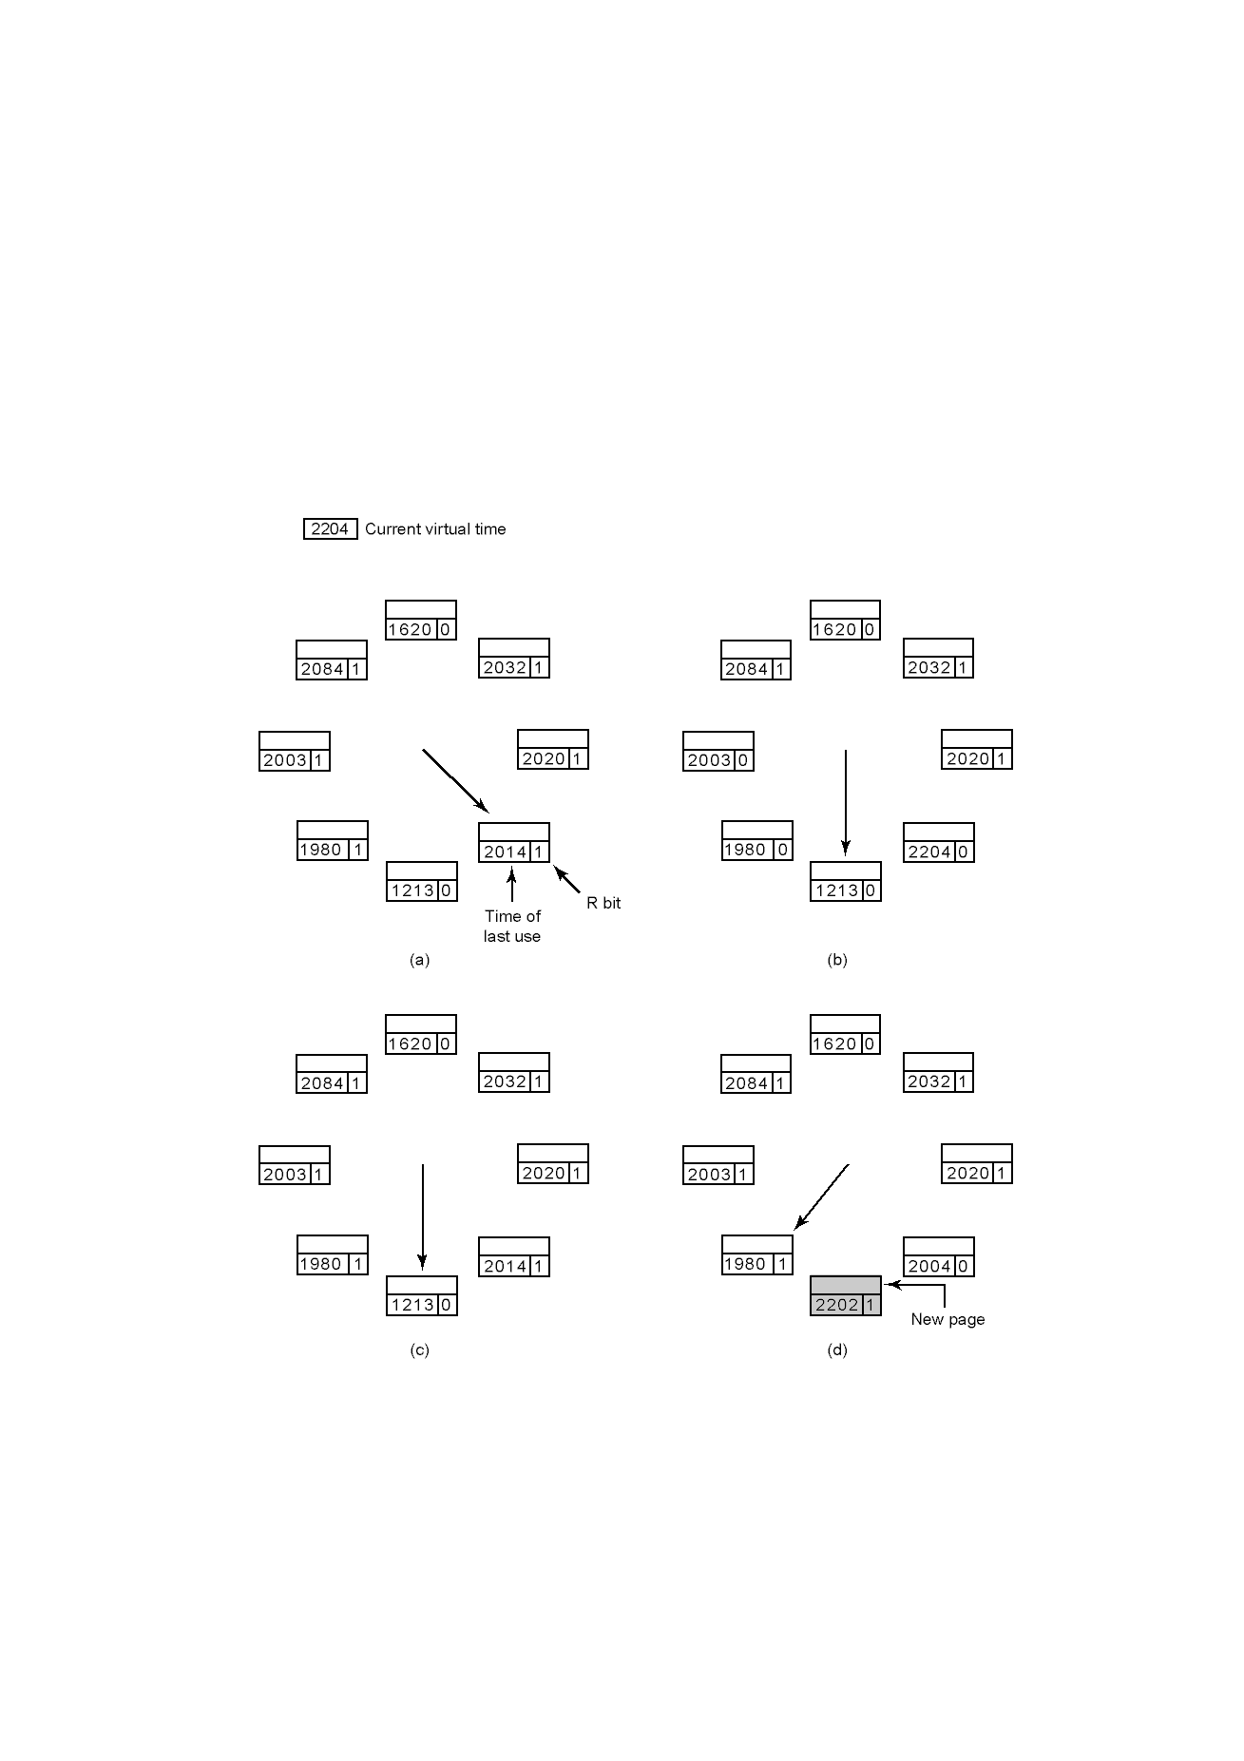
The WSClock Page Replacement Algorithm
Operation of the WSClock algorithm

Slide 31
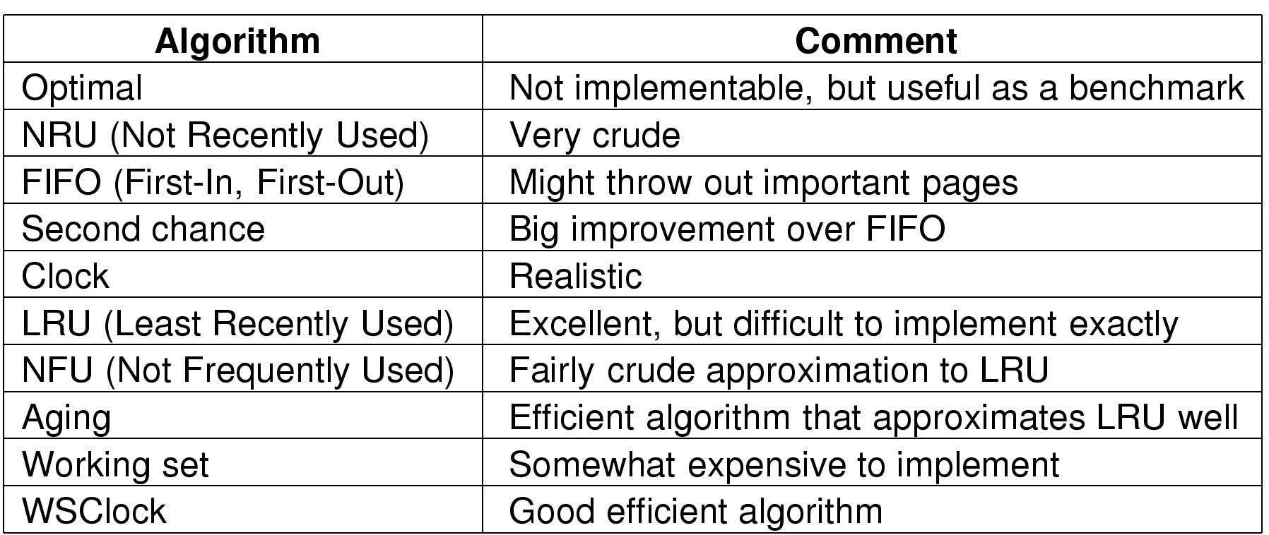
Review of Page Replacement Algorithms

Slide 32
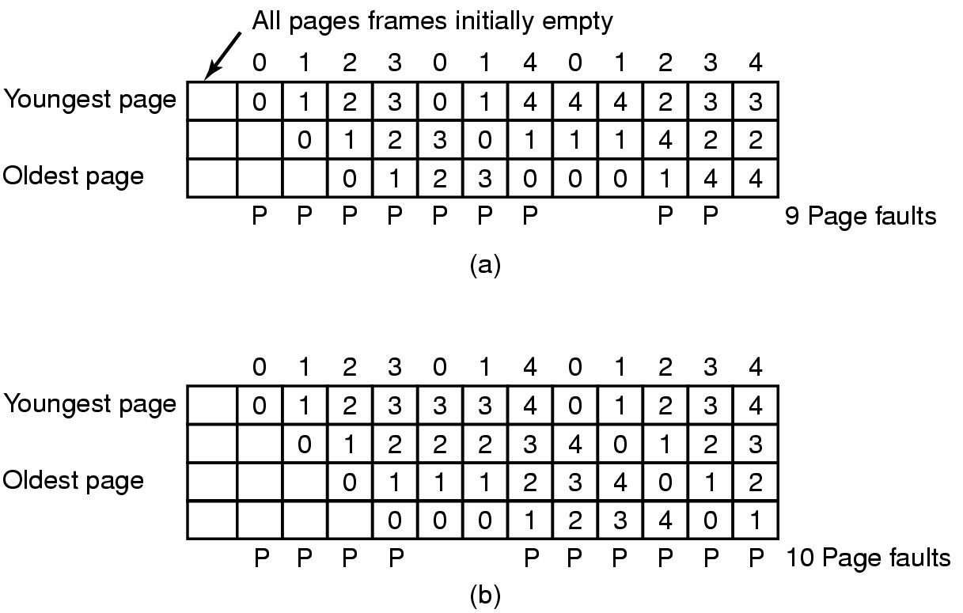
Modeling Page Replacement Algorithms
Belady's Anomaly
FIFO with 3 page frames
FIFO with 4 page frames
P's show which page references show page faults

Slide 33
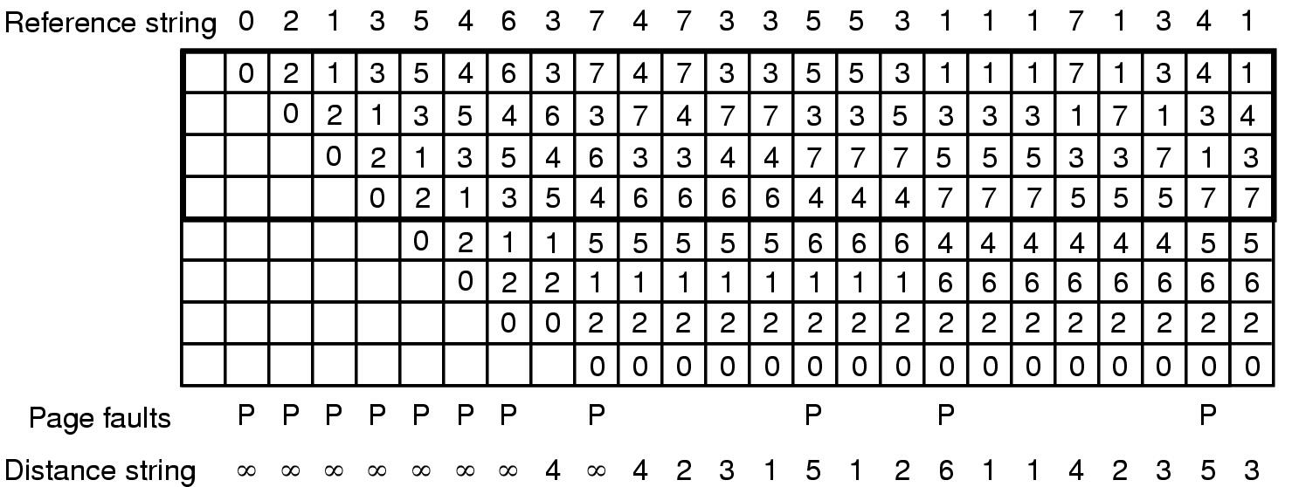
Stack Algorithms
7 4 6 5
State of memory array, M, after each item in reference string is processed

Slide 34
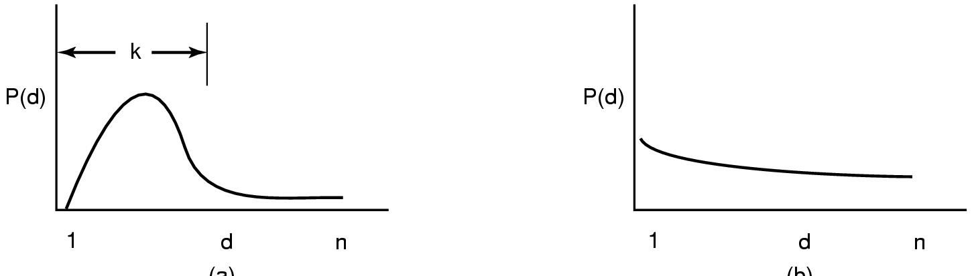
The Distance String
Probability density functions for two hypothetical distance strings

Slide 35
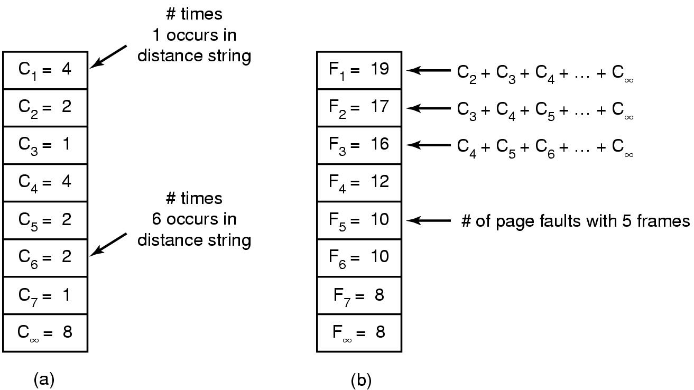
The Distance String
Computation of page fault rate from distance string
  the C vector
  the F vector

Slide 36
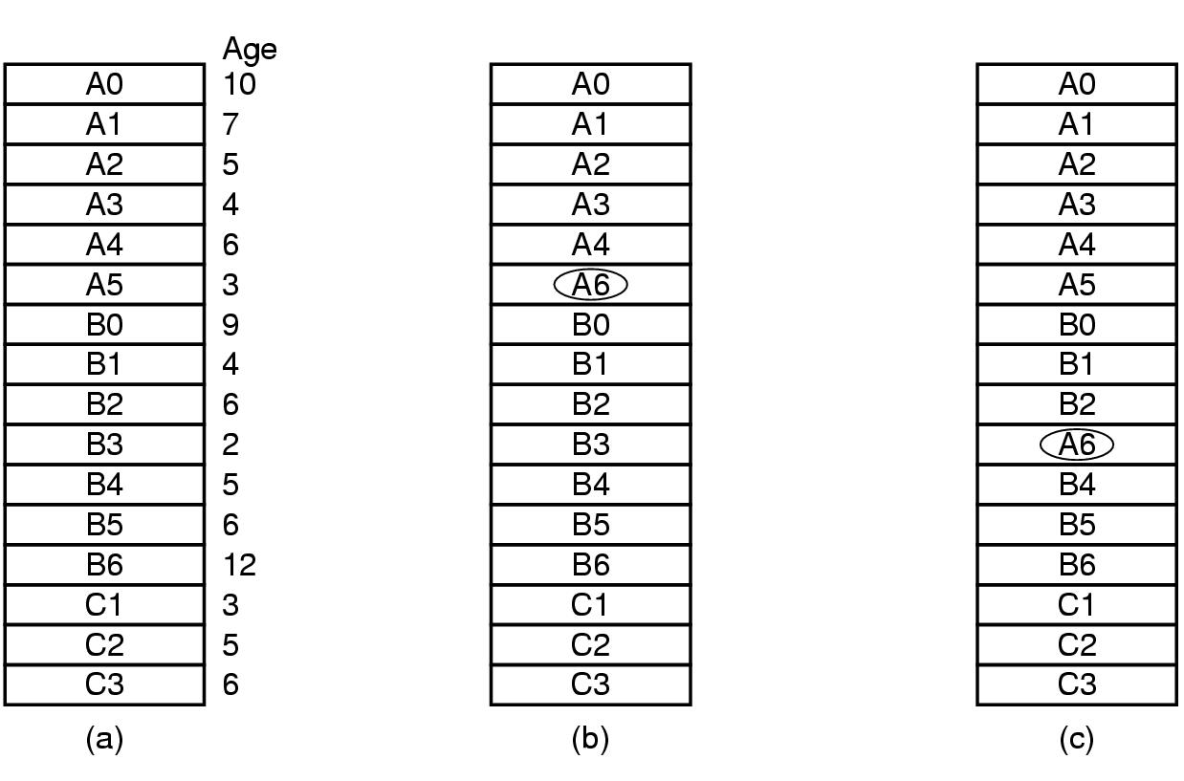
Design Issues for Paging Systems
Local versus Global Allocation Policies (1)
Original configuration
Local page replacement
Global page replacement

Slide 37
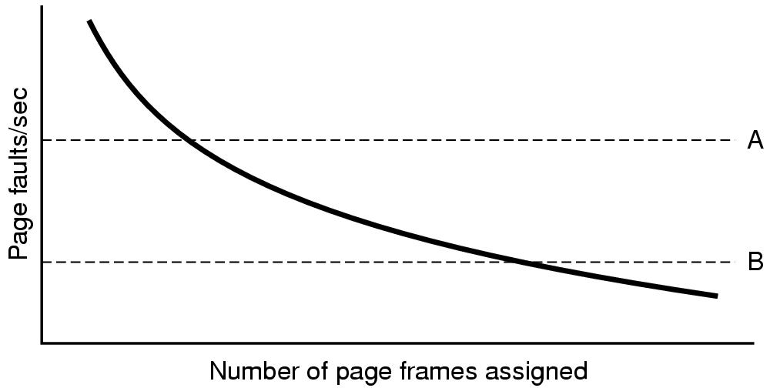
Local versus Global Allocation Policies (2)
Page fault rate as a function of the number of page frames assigned

Slide 38
Load Control
Despite good designs, system may still thrash
When PFF algorithm indicates
  some processes need more memory
  but no processes need less
Solution :
Reduce number of processes competing for memory
  swap one or more to disk, divide up pages they held
  reconsider degree of multiprogramming

Slide 39
Page Size (1)
Small page size
Advantages
  less internal fragmentation
  better fit for various data structures, code sections
  less unused program in memory
Disadvantages
  programs need many pages, larger page tables

Slide 40
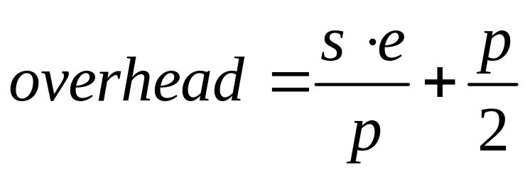
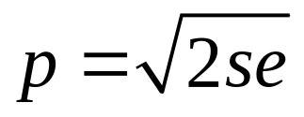
Page Size (2)
Overhead due to page table and internal fragmentation
Where
  s = average process size in bytes
  p = page size in bytes
  e = page entry
page table space
internal fragmentation
Optimized when

Slide 41
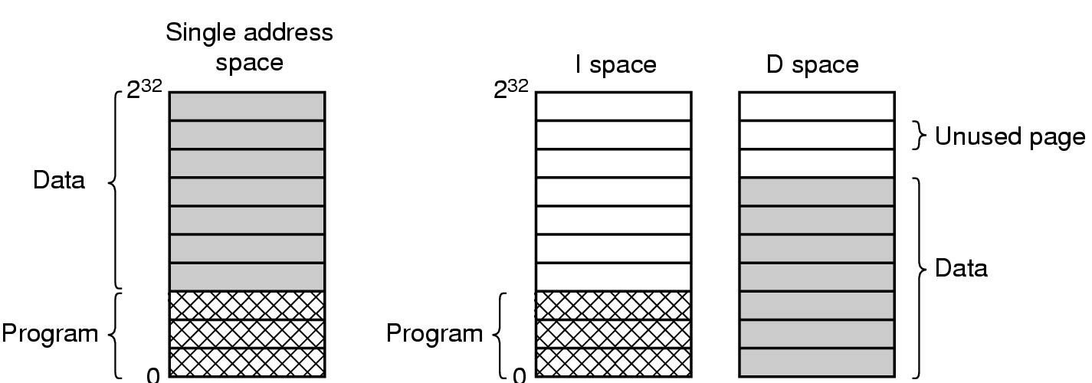
Separate Instruction and Data Spaces
One address space
Separate I and D spaces

Slide 42
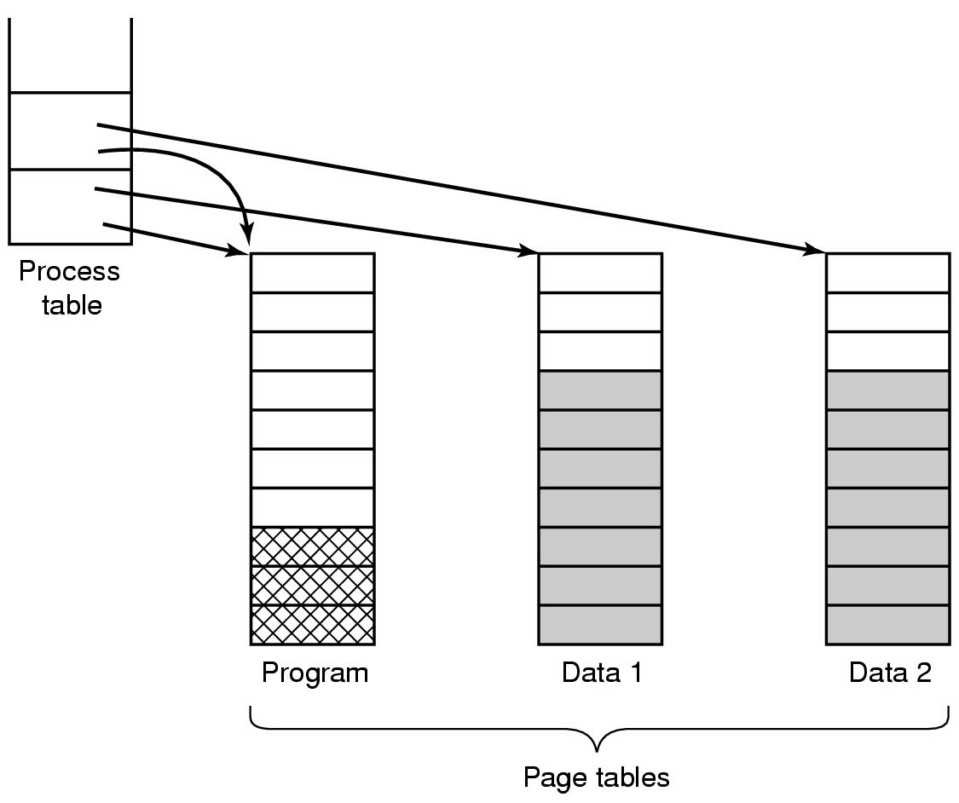
Shared Pages
Two processes sharing same program sharing its page table

Slide 43
Cleaning Policy
Need for a background process, paging daemon
  periodically inspects state of memory
When too few frames are free
  selects pages to evict using a replacement algorithm
It can use same circular list (clock)
  as regular page replacement algorithmbut with diff ptr

Slide 44
Implementation Issues
Operating System Involvement with Paging
Four times when OS involved with paging
Process creation
  determine program size
  create page table
Process execution
  MMU reset for new process
  TLB flushed
Page fault time
  determine virtual address causing fault
  swap target page out, needed page in
Process termination time
  release page table, pages

Slide 45
Page Fault Handling (1)
Hardware traps to kernel
General registers saved
OS determines which virtual page needed
OS checks validity of address, seeks page frame
If selected frame is dirty, write it to disk

Slide 46
Page Fault Handling (2)
OS brings schedules new page in from disk
Page tables updated
Faulting instruction backed up to when it began
Faulting process scheduled
Registers restored
Program continues

Slide 47
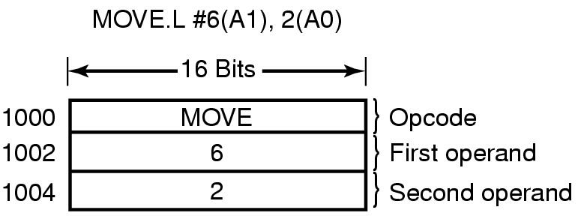
Instruction Backup
An instruction causing a page fault

Slide 48
Locking Pages in Memory
Virtual memory and I/O occasionally interact
Proc issues call for read from device into buffer
  while waiting for I/O, another processes starts up
  has a page fault
  buffer for the first proc may be chosen to be paged out
Need to specify some pages locked
  exempted from being target pages

Slide 49
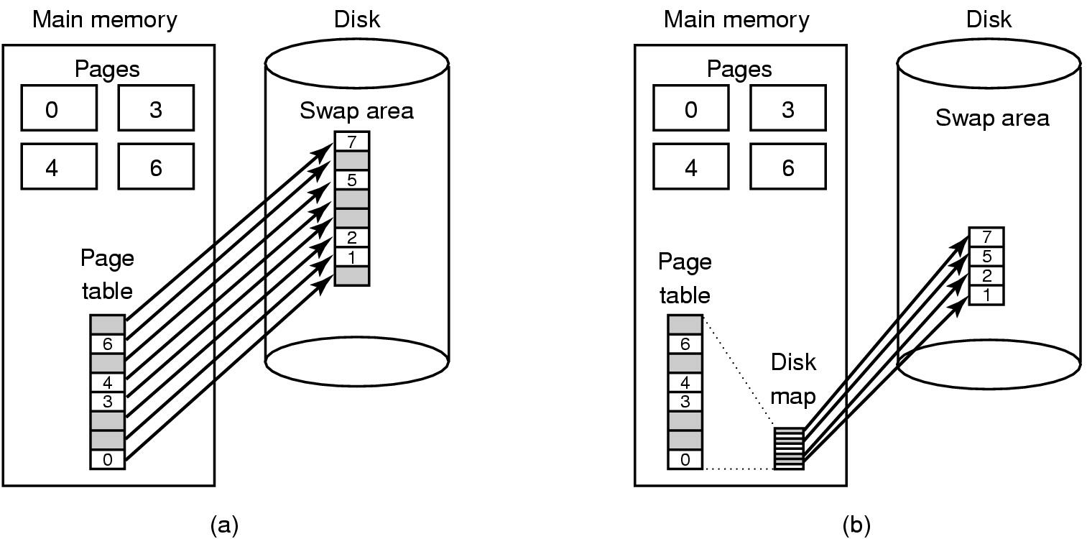
Backing Store
(a) Paging to static swap area
(b) Backing up pages dynamically

Slide 50
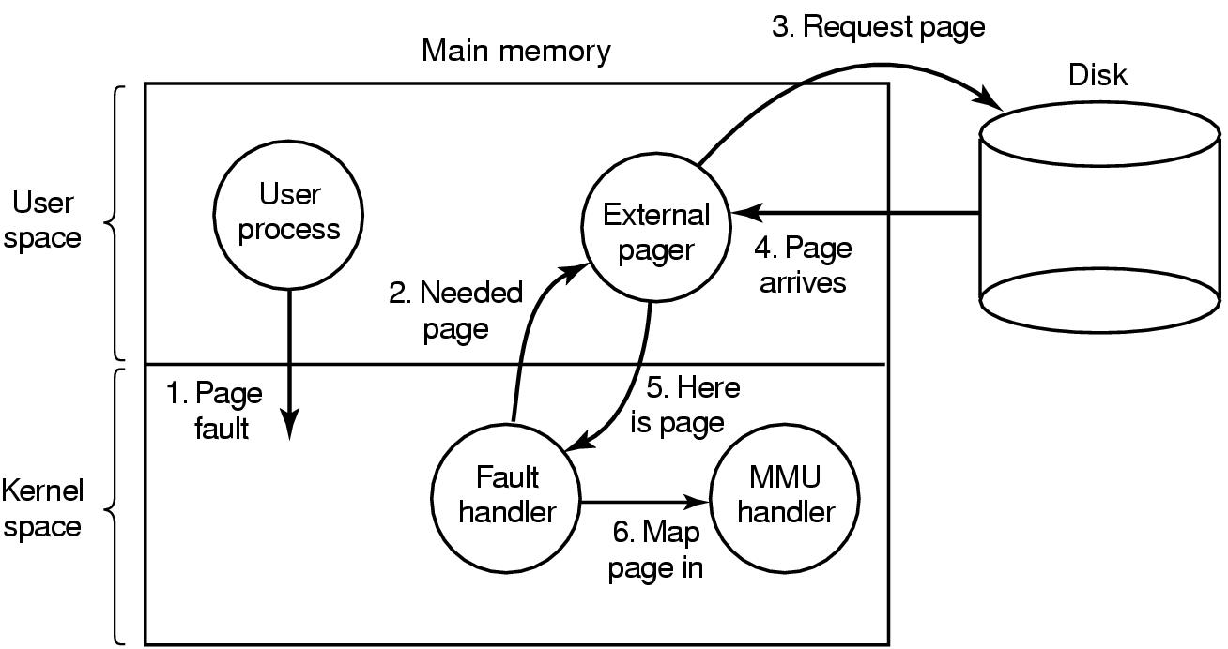
Separation of Policy and Mechanism
Page fault handling with an external pager

Slide 51

Segmentation (1)
One-dimensional address space with growing tables
One table may bump into another

Slide 52
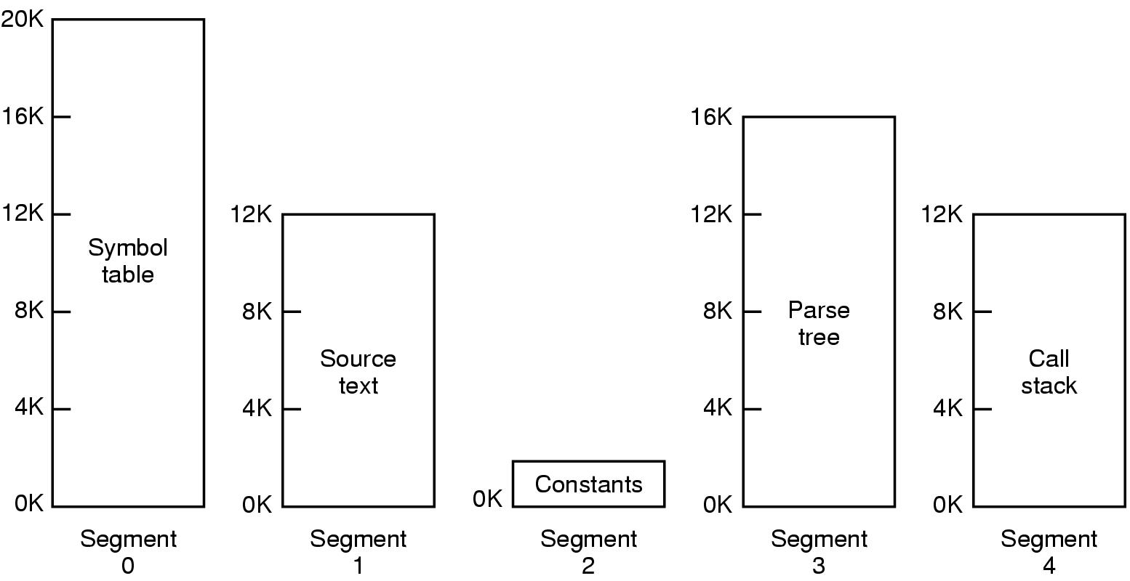
Segmentation (2)
Allows each table to grow or shrink, independently

Slide 53

Segmentation (3)
Comparison of paging and segmentation

Slide 54
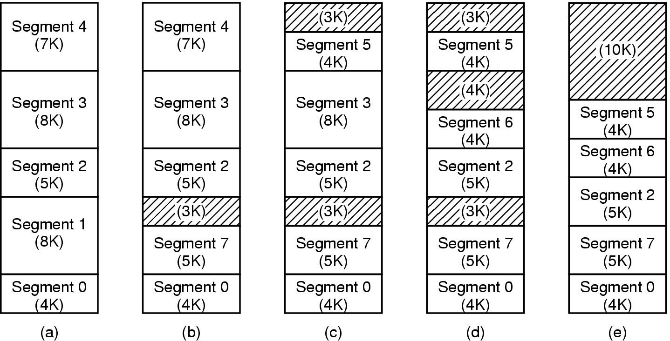
Implementation of Pure Segmentation
(a)-(d) Development of checkerboarding
(e) Removal of the checkerboarding by compaction

Slide 55
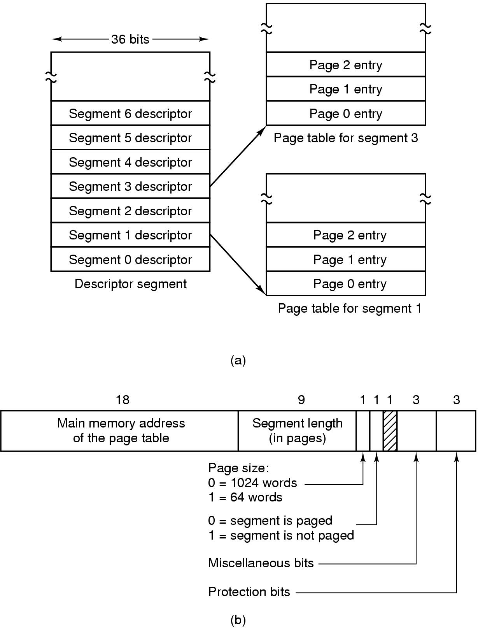
Segmentation with Paging: MULTICS (1)
Descriptor segment points to page tables
Segment descriptor – numbers are field lengths

Slide 56
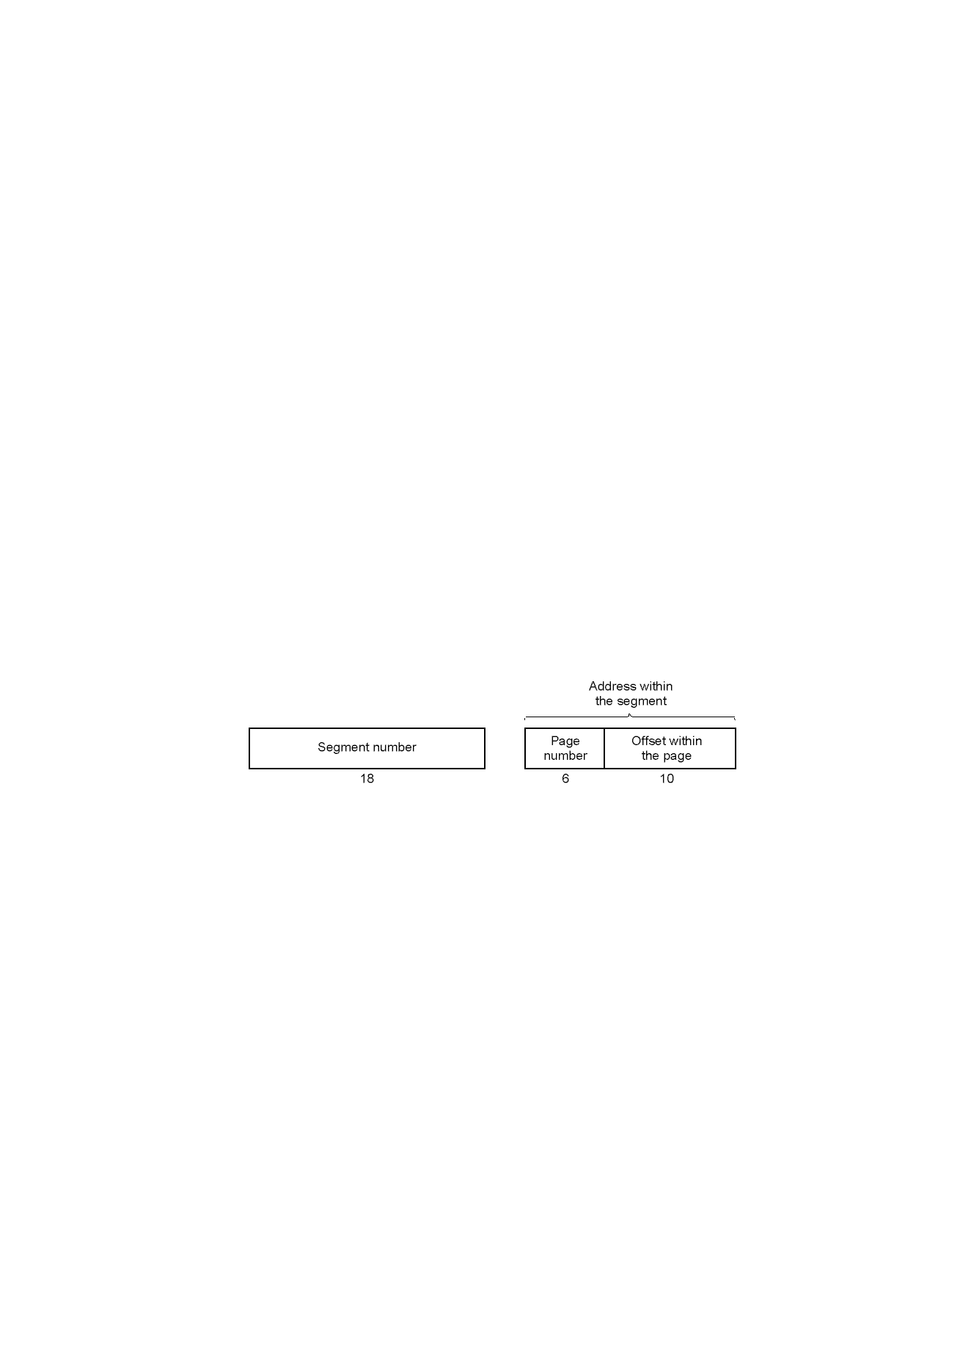
Segmentation with Paging: MULTICS (2)
A 34-bit MULTICS virtual address

Slide 57
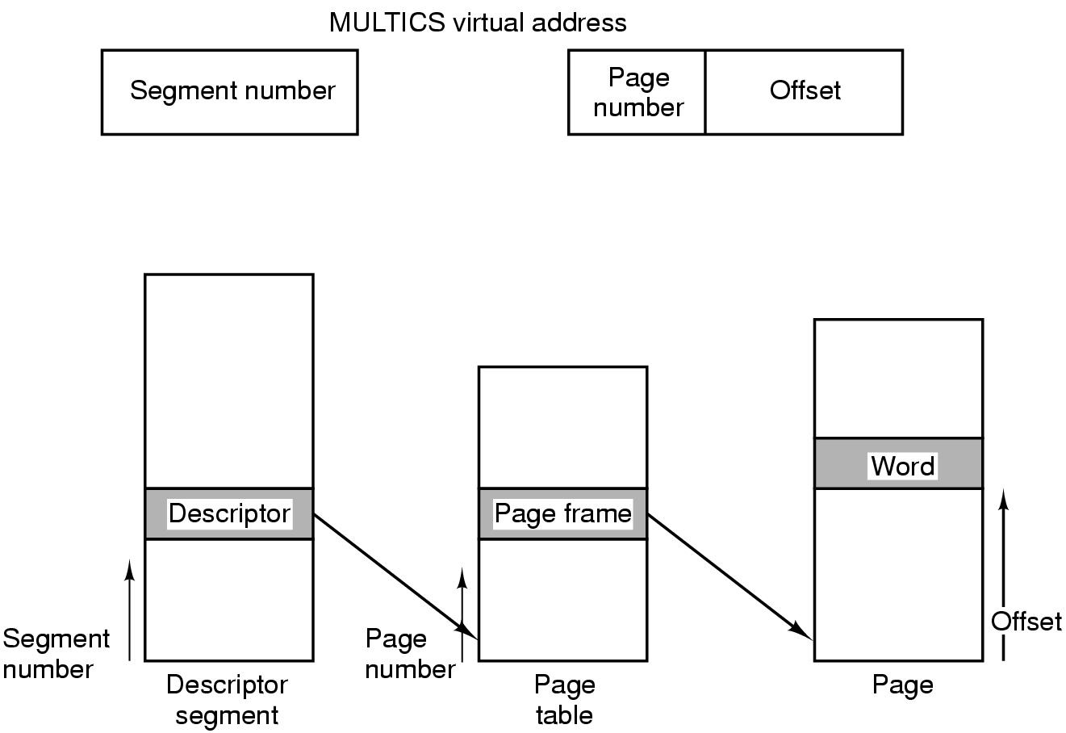
Segmentation with Paging: MULTICS (3)
Conversion of a 2-part MULTICS address into a main memory address

Slide 58
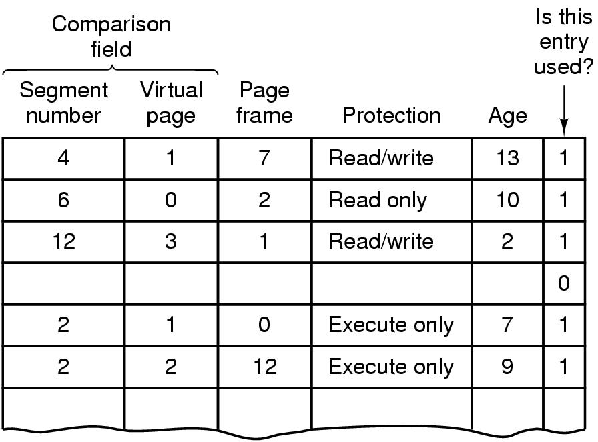
Segmentation with Paging: MULTICS (4)
Simplified version of the MULTICS TLB
Existence of 2 page sizes makes actual TLB more complicated

Slide 59
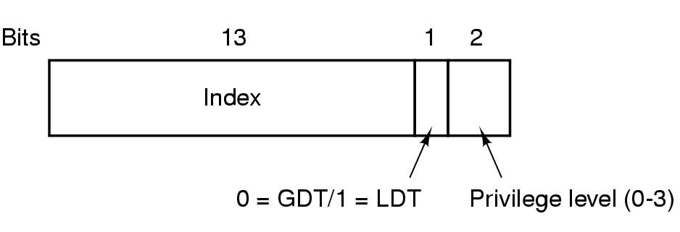
Segmentation with Paging: Pentium (1)
A Pentium selector

Slide 60
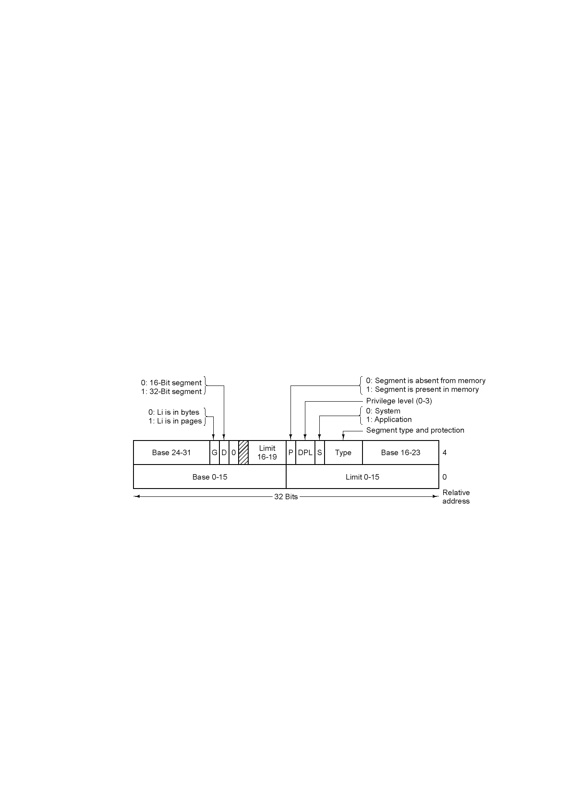
Segmentation with Paging: Pentium (2)
Pentium code segment descriptor
Data segments differ slightly

Slide 61
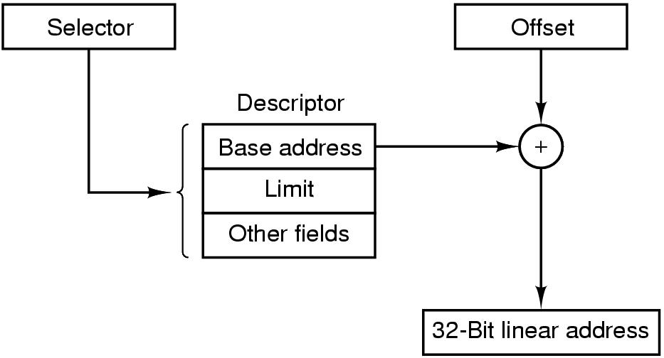
Segmentation with Paging: Pentium (3)
Conversion of a (selector, offset) pair to a linear address

Slide 62
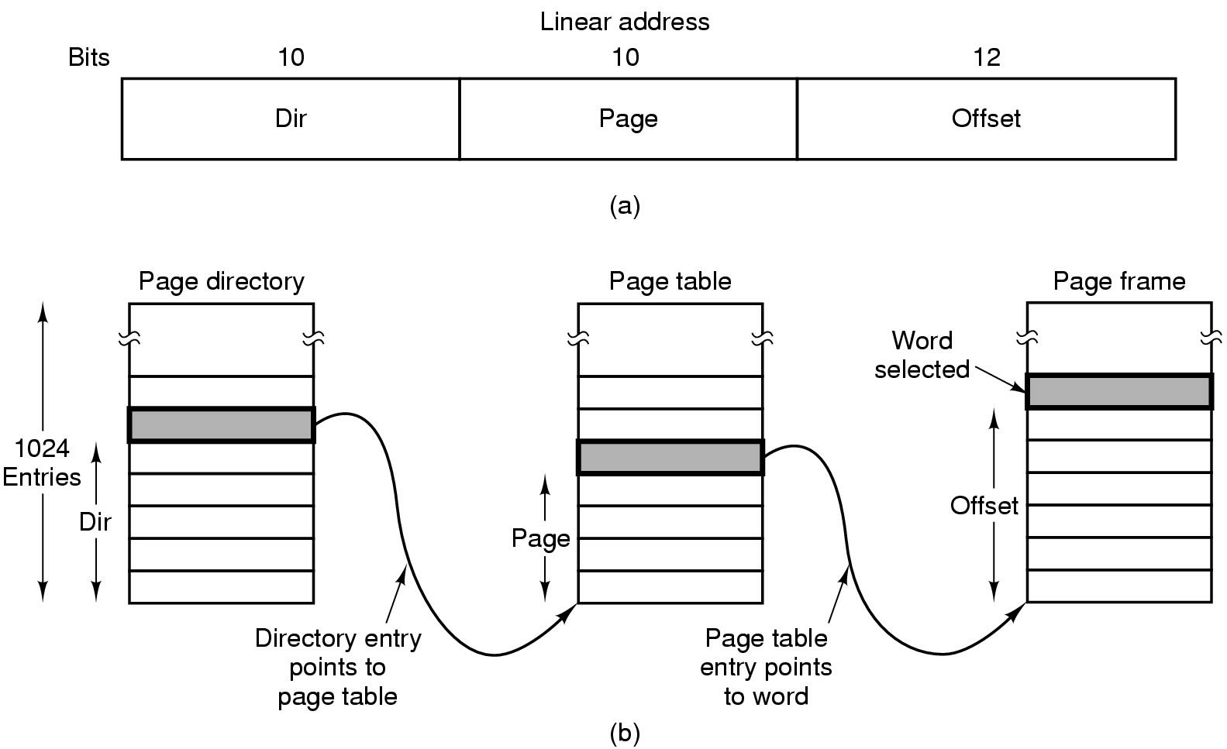
Segmentation with Paging: Pentium (4)
Mapping of a linear address onto a physical address

Slide 63
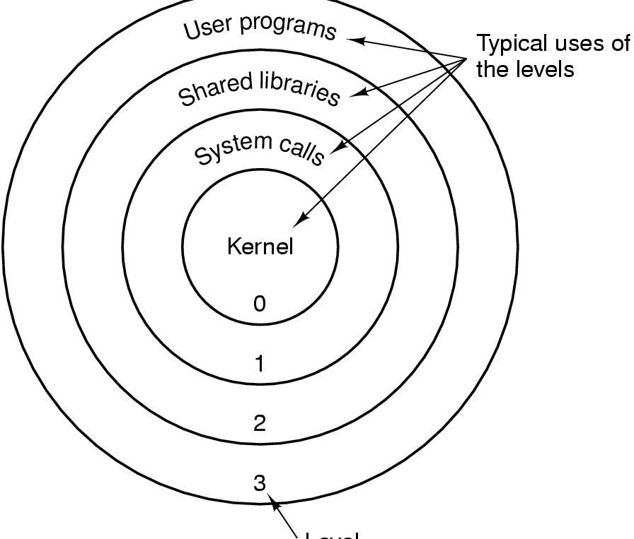
Segmentation with Paging: Pentium (5)
Level
Protection on the Pentium

